Slide 1
Appropriate Use of Formative Assessment in a Lecture-Based Course
Dan Thompson
Manager of Instructional Design and Educational Technology

Slide 2
Today’s Learning Objectives
Identify methods of formative assessment that will assist in improving learner retention and student outcomes.
Determine appropriate opportunities to implement formative assessments in the large lecture classroom to add value to the learning process.
Create meaningful and valuable formative assessments.

Slide 3
What is Formative Assessment
Formative assessment refers to a wide variety of methods that teachers use to conduct in-process evaluations of student comprehension, learning needs, and academic progress during a lesson, unit, or course. Formative assessments help teachers identify concepts that students are struggling to understand, skills they are having difficulty acquiring, or learning standards they have not yet achieved so that adjustments can be made to lessons, instructional techniques, and academic support.
http://edglossary.org/formative-assessment/

Slide 4
More About Formative Assessment
Two key additions need to be added to the previous definition to complete the formative assessment process:
Students completing a self assessment
Providing feedback to students
Focus on the task, not the student
Make sure feedback is given in a way students understand it

Slide 5
Why and When Should we use Formative Assessment?
Has a positive impact on student learning
Improves overall student achievement
Narrows the gap between low and high achievers
Prepare students for summative assessments
Help solidify basic information
Opportunities for students to practice difficult content

Slide 6
Formative Assessment at OSU
What forms of formative assessment do OSU faculty currently use?
Nearpod
ExamSoft assessments
In and out of the classroom
Team-based learning (TBL)
Case-based learning (PBL)
CPS
Kahoot
Panopto assessment items

Slide 7
Alignment!
Formative assessments should be aligned with:
School mission
Course goals
Learning objectives
Instructional methods
Summative assessments
Integrate course content (systems courses)

Slide 8
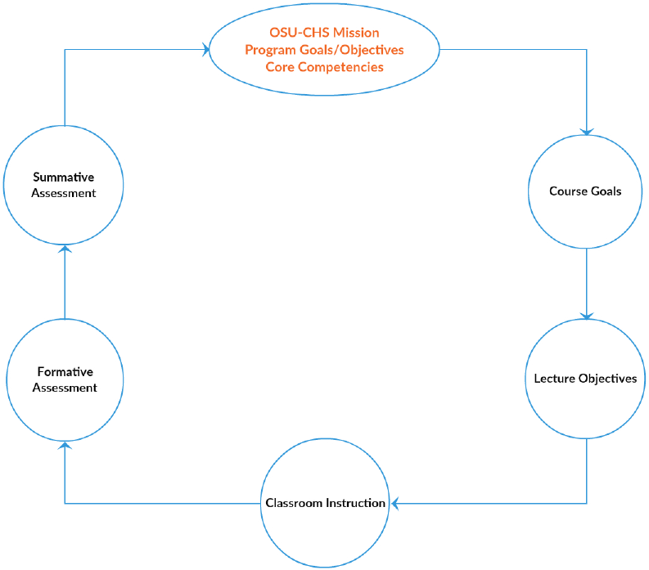

Slide 9
Making it Count
Make sure your use of formative assessment has a purpose
Which content needs to be reviewed?
Determine future instructional methods
Reflect!
What were my goals for teaching this session?
How did I assess students’ learning of my LOs?
How satisfied am I with my students’ progress?
What area(s) should I target to improve student learning in this course

Slide 10
Formative Assessment Techniques
TBL
PBL
Quizzes
Small-group or large class discussion
Articulate/Nearpod
Interactive PPT presentations
Think-Pair-Share

Slide 11
Formative Assessment Techniques
Pre-class Assessment
IRAT/GRAT
Frequent classroom assessment breaks during class
Take-home quiz
Peer review
Students reviewing their peer’s short answer submissions

Slide 12
Moving Forward
Match content with formative assessment technique
Include method of providing feedback
Faculty
Peer
Activity
Preparation
Organization
Explanation – clearly describe expectations to students

Slide 13
References
Black, P., & Wiliam, D. (2006). Inside the black box: Raising standards through classroom assessment. Granada Learning.
Formative Assessment. (2014, April 29). Retrieved September 4, 2016, from http://edglossary.org/formative-assessment/
Rushton, A. (2005). Formative assessment: a key to deep learning?. Medical teacher, 27(6), 509-513.
The Value of Formative Assessment. (2006). Retrieved September 4, 2016, from http://www.fairtest.org/value-formative-assessment
Yorke, M. (2001). Formative assessment and its relevance to retention.Higher Education Research and Development, 20(2), 115-126.

Slide 14
Thank you!!
Questions??
Dan.thompson@okstate.edu
@danthompsonidts

